Slide 1
Factoring Large Numbers by
Parallelizing Dixon’s Method
Benjamin Zagorsky and
Loren McGinnis

Slide 2
Factoring Algorithms and RSA
RSA, keystone of public key cryptography, assumes factoring is hard
Given numbers N = p*q, where p and q are large primes, factoring N takes time exponential in the number of digits of N
But N must be large for this to matter. How large is large enough to be secure?

Slide 3
Congruence of Squares
If you can find two numbers, x and y, such that x² ≡ y² (mod N), then the numbers
(x + y) and (x – y) will each contain a factor of N
Euclidian algorithm computes the GCD to extract these factors very efficiently

Slide 4
Dixon’s Method
Numbers that result in a congruence of squares are fairly rare
Much more abundant are B-smooth numbers: numbers that only have prime factors less than or equal to B
Dixon’s method finds enough numbers x such that (x² mod N) is B-smooth

Slide 5
Dixon’s Method (cont’d)
Given enough such numbers x_{i}, some subset of the x_{i}’s will have Π[x_{i}²mod N] be a square (thus constructing a congruence of squares)
But since the x_{i}²mod n are all B-smooth, “enough” is only a few more than the number of primes less than or equal to B

Slide 6
Finding B-Smooth Numbers
Easy to parallelize; each number from N^{0.5} to N can be checked independent of others; use CUDA!
But early termination is critical to the efficiency of Dixon’s method
Must have some means of determining when enough numbers have been found
Early termination implemented on the block level using shared memory as a flag

Slide 7
Scaling Up
Real RSA uses large numbers (1024 bits)
Biggest data type in CUDA is 64 bits
Given the need to square numbers, this only allows for factoring 32 bit numbers
Need bignum capability in CUDA; doesn’t currently exist
Use PyCUDA to write and dynamically generate necessary bignum code

Slide 8
Given PyCuda…
The larger B, the faster the number search will run, at the expense of more post-processing
Use PyCUDA to metaprogram a flexible B value
Also, use PyCUDA for auto-tuning several aspects of the code to make factoring run even faster

Slide 9
How Does it Do?
10967535067 = 104729*104723
(33 bits) in 0.15 sec
374485250303 = 611951*611953
(39 bits) in 1.54 sec
1689542430967 = 1299821*1299827
(41 bits) in 10.3 sec
Compare to non-CUDA implementation:
146385797 = 12101*12097
(only 28 bits) in 8 sec

Slide 10
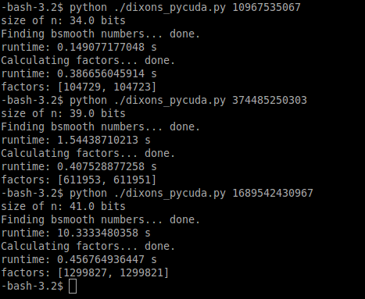
How Does it Do?

Slide 11
Conclusion
Still scaling exponentially
CUDA gives a good speedup (800x), but with current computing power it is not enough to break 1024 in a reasonable time scale
Your credit card numbers are still safe from us :)

